Slide 1
Network Security
National Taiwan University
of Science and Technology

Slide 2
Support Vector Machines(SVM)

Slide 3
Why SVM?
Powerful state-of-the-art classifier
Strong theoretical foundations
  Vapnik-Chervonenkis (VC) theory
Regularization properties
  Good generalization to novel data
Algorithm of choice for challenging high-dimensional data
  Text, image, bioinformatics, intrusion, etc

Slide 4
Main concept of the algorithm
The aim of Support Vector Machine (SVM) is to find the best classification function to distinguish between members of the two classes in the training data.
The original idea of SVM is to use a linear separating hyperplane to create a classifier.
From Wikipedia, SVMs are a set of related supervised learning methods used for classification and regression. They belong to a family of generalized linear classifiers.

Slide 5
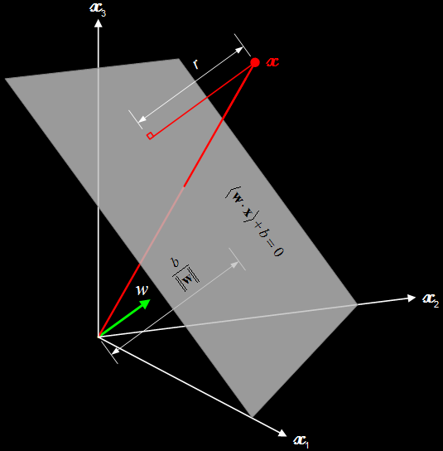

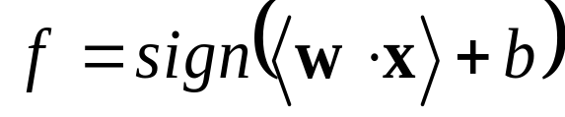
Conceptual Simplicity
An SVM model defines a hyperplane in the feature space in terms of coefficients (w) and a bias term (b)
Prediction:

Slide 6
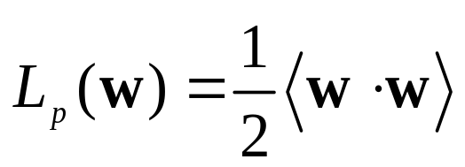
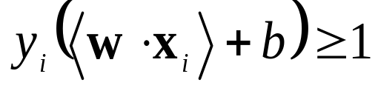
SVM Optimization Problem: Linearly Separable Case
Minimize
, subject to
Maximum separation between classes
Dimensionality insensitive
Sparse solution
Single global minimum
Solvable in polynomial time…
support vectors

Slide 7
Kernel Classifiers
Transform data via non-linear mapping to an inner product feature space
  Gaussian, polynomial kernels
Train a linear machine in the new feature space

Slide 8
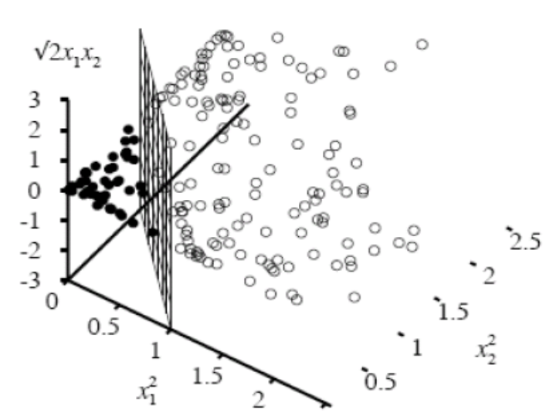
Description of the SVM
我們考慮以下形式的樣本點，其中ci為1或−1 ，用以表示數據點屬於哪個類
其每個元素都被縮放到[0,1]或[-1,1].目的是防止的隨機變量主導分類過程
SVM希望透過一個超平面正確的把它們分開，超平面的數學式可以寫作
  W是垂直於分類超平面的向量
  b是偏移量，目的是增加間隔，
  如果没有b，那超平面必定會通
  過原點，就會限制了SVM的靈活
  性

Slide 9
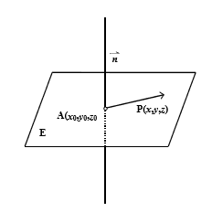
Description of the SVM
如何求平面的方程式
(a)點法式：
若平面E法向量→ ■ n =(a,b,c)且過點A(x0,y0,z0)， 則平面E的方程式為a(x−x0)+b(y−y0)+c(z−z0)=0。
[證明]：
在平面E上任取一點P其坐標為(x,y,z)，
則AP⊥→ ■ n 所以(x−x0,y−y0,z−z0)⋅(a,b,c)=0 ⇒a(x−x0)+b(y−y0)+c(z−z0)=0
反過來說滿足方程式
a(x−x0)+b(y−y0)+c(z−z0)=0的解
Q(x,y,z) ⇒AQ⊥→ ■ n ⇒Q落在平面E上。
將方程式a(x−x0)+b(y−y0)+c(z−z0)=0 化簡可得ax+by+cz+d=0的方程式
Compared to
W= (a, b, c), X= (x, y, z), b=-d

Slide 10
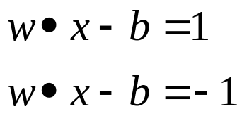
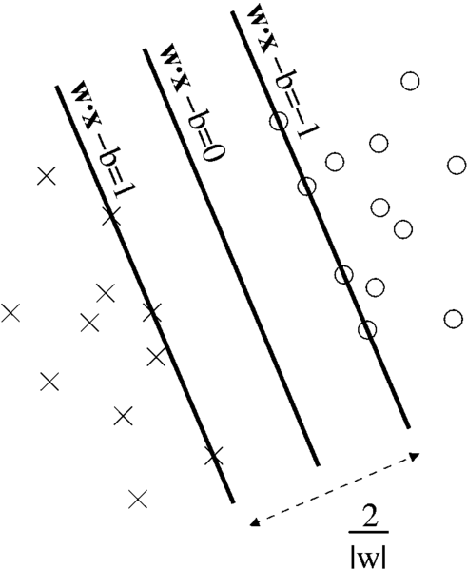
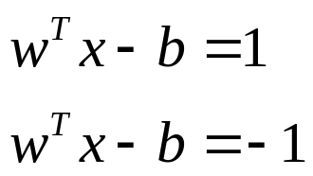
Description of the SVM
由於我們是要找到兩個類別與超平面之間最大的間隔，因我們必須知道Support Vector以及與最佳超平面平行的且離Support Vector最近的超平面
這些平行超平面可以內積表示為
W和X是列向量
另一種用矩陣寫法為
W和X是行向量
透過運算我們不難得到這兩個超平面之間的距離是 2/|w|，為了使得樣本數據點都在超平面的間隔區以外,我們需要保證對於所有的 i 滿足其中的一個條件
上面兩個式子可以寫成
最後求出滿足上式最小化的

Slide 11
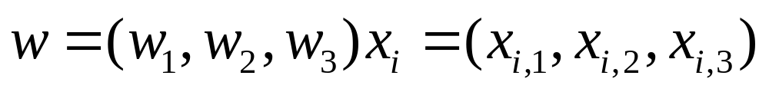
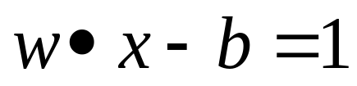
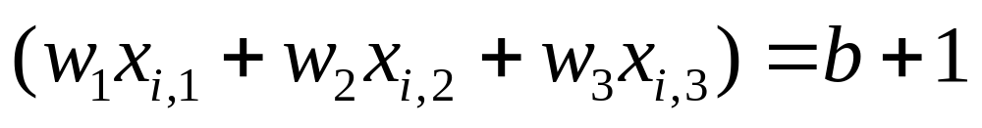
An Example of SVM
Assume
Then
Can be written as
W is the normal vector and x is a plane in a 3-dimensional space

Slide 12




Distance to a plane
點到直線的距離
直線定義為 ax + by + c = 0，點的座標為 (x0, y0)，則它們之間的距離為：
點到平面的距離
若點坐標為(x0,y0,z0),平面為Ax+By+Cz+D=0,則點到平面的距離為:
若直線分別為 ax + by + c1 = 0, 和 ax + by + c2 = 0, 則它們之間的距離為:
若兩平為 Ax + By + Cz+D1 = 0, 和 Ax + By +Cz+ D2 = 0, 則他們之間的距離為:

Slide 13
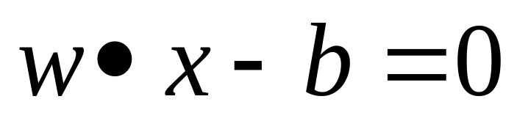
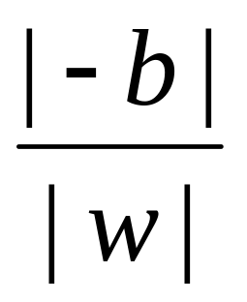
The distance between the origin to an plane in SVM
Let the plane be defined as
The distance between the origin to aboveplane is

Slide 14
α
Linear Classifiers
x
f
y^{est}
f(x,w,b) = sign(w x + b)
denotes +1
denotes -1
w x + b>0
w x + b=0
How would you classify this data?
w x + b<0

Slide 15
α
Linear Classifiers
x
f
y^{est}
f(x,w,b) = sign(w x + b)
denotes +1
denotes -1
How would you classify this data?

Slide 16
α
Linear Classifiers
x
f
y^{est}
f(x,w,b) = sign(w x + b)
denotes +1
denotes -1
How would you classify this data?

Slide 17
α
Linear Classifiers
x
f
y^{est}
f(x,w,b) = sign(w x + b)
denotes +1
denotes -1
Any of these would be fine..
..but which is best?

Slide 18
α
Linear Classifiers
x
f
y^{est}
f(x,w,b) = sign(w x + b)
denotes +1
denotes -1
How would you classify this data?
Misclassified
to +1 class

Slide 19
α
α
Classifier Margin
Classifier Margin
x
x
f
f
y^{est}
y^{est}
f(x,w,b) = sign(w x + b)
f(x,w,b) = sign(w x + b)
denotes +1
denotes -1
denotes +1
denotes -1
Define the margin of a linear classifier as the width that the boundary could be increased by before hitting a datapoint.
Define the margin of a linear classifier as the width that the boundary could be increased by before hitting a datapoint.

Slide 20
α
Maximum Margin
x
f
y^{est}
Maximizing the margin is good according to intuition and PAC theory
Implies that only support vectors are important; other training examples are ignorable.
Empirically it works very very well.
f(x,w,b) = sign(w x + b)
denotes +1
denotes -1
The maximum margin linear classifier is the linear classifier with the, um, maximum margin.
This is the simplest kind of SVM (Called an LSVM)
Support Vectors are those datapoints that the margin pushes up against
Linear SVM

Slide 21
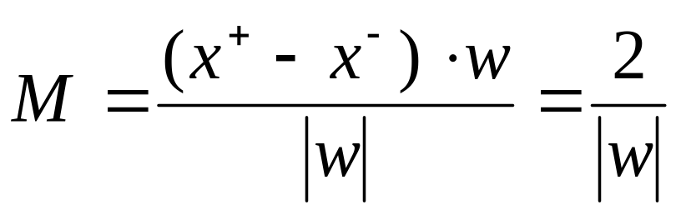
Linear SVM Mathematically
x⁺
M=Margin Width
“Predict Class = +1” zone
X⁻
wx+b=1
“Predict Class = -1” zone
wx+b=0
wx+b=-1
(x⁺-x⁻⁾ 在單位法向量的偏量即為距離
What we know:
w . x⁺ + b = +1
w . x⁻ + b = -1
w . (x⁺-x⁻⁾ = 2

Slide 22
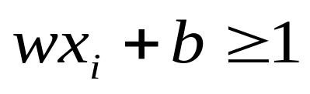
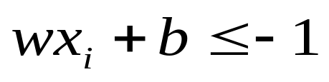
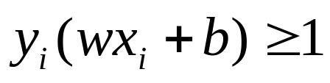
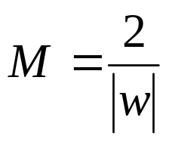
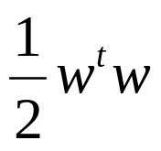
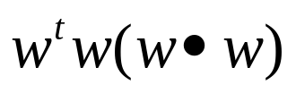
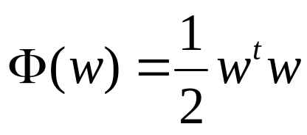


Linear SVM Mathematically
Goal: 1) Correctly classify all training data
if y_{i} = +1
if y_{i} = -1
for all i
2) Maximize the Margin
same as minimize
If we use |w|, we need to find the root of
For simplicity, we then square |w|.
We can formulate a Quadratic Optimization Problem and solve for w and b
Minimize
subject to

Slide 23
Linear SVMs: Overview
The classifier is a separating hyperplane.
Most “important” training points are support vectors; they define the hyperplane.
Quadratic optimization algorithms can identify which training points x_{i} are support vectors with non-zero Lagrangian multipliers α_{i}.
Both in the dual formulation of the problem and in the solution training points appear only inside dot products:
Find α₁…α_{N} such that
Q(α) =Σα_{i} - ½ΣΣα_{i}α_{j}y_{i}y_{j}x_{i}^{T}x_{j} is maximized and
(1) Σα_{i}y_{i} = 0
(2) 0 ≤ α_{i} ≤ C for all α_{i}
f(x) = Σα_{i}y_{i}x_{i}^{T}x + b

Slide 24
Linear SVMs: Overview
The classifier is a separating hyperplane.
Most “important” training points are support vectors; they define the hyperplane.
Quadratic optimization algorithms can identify which training points x_{i} are support vectors with non-zero Lagrangian multipliers α_{i}.
Both in the dual formulation of the problem and in the solution training points appear only inside dot products:
Find α₁…α_{N} such that
Q(α) =Σα_{i} - ½ΣΣα_{i}α_{j}y_{i}y_{j}x_{i}^{T}x_{j} is maximized and
(1) Σα_{i}y_{i} = 0
(2) 0 ≤ α_{i} ≤ C for all α_{i}
f(x) = Σα_{i}y_{i}x_{i}^{T}x + b

Slide 25
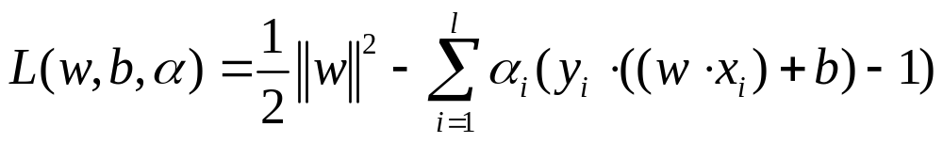
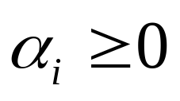
找到最佳超平面是一個二次方程式的問題，我們可以使用Largangian定理與Lagrangian算子(Multipliers)來解決這個問題：
Lagrangian:
Lagrangian multipliers:

Slide 26
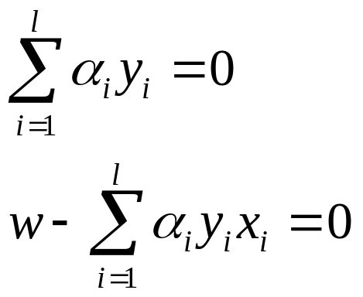
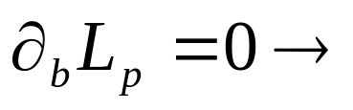
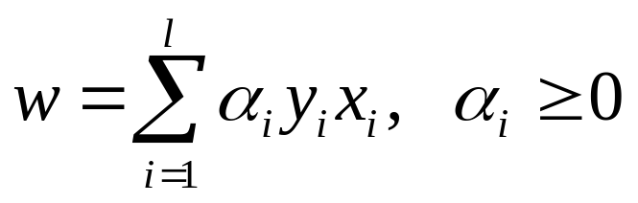
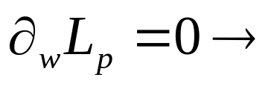
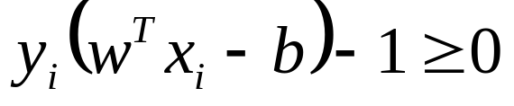

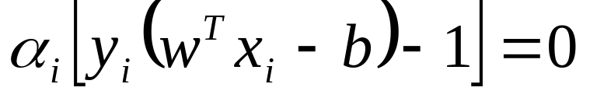
將分別對w跟b做偏微分，令其為0，可求得下列兩個式子：
Lagrange multiplier condition
complementary slackness
KKT條件(Karush-Kuhn-Tucker conditions)

Slide 27
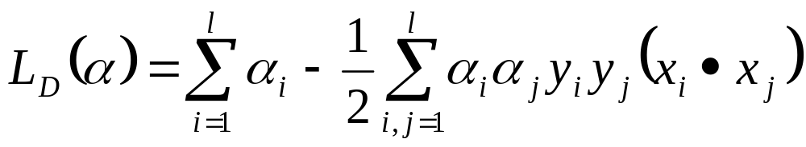
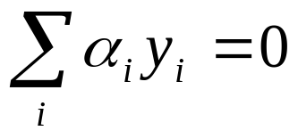
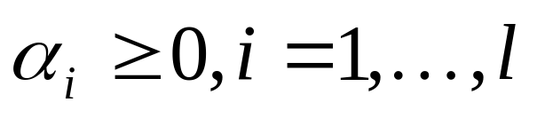
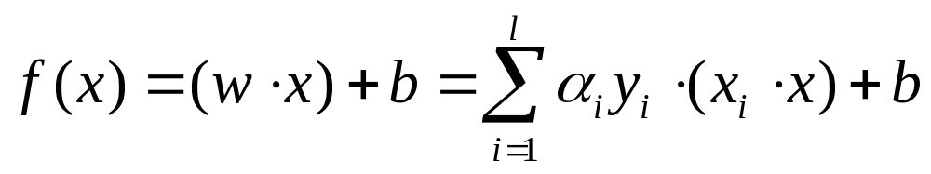
把 w 放進 Lagrangian 裡我們能得到一個dual optimization 問題，它是一個最大化問題，
maximize
Subject to
Decision function

Slide 28

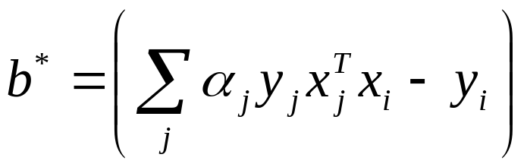
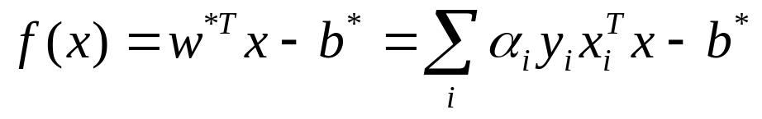
Support Vector
當我們把訓練資料(training data)丟進來時，有些點
會滿足上面的KKT條件，而這些點就是剛好落在
support hyperplan上面的點，這些點又被稱為
support vector，並且它們的 α_{i} 會大於 0。換句話說
，只有α_{i} 大於 0的那些點 對
才有貢獻
有了support vector 之後，我們就可以用它們來判斷新加入的點是屬於那一邊的集合, How to get w, b ?

Slide 29
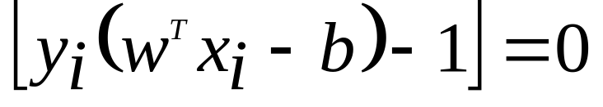
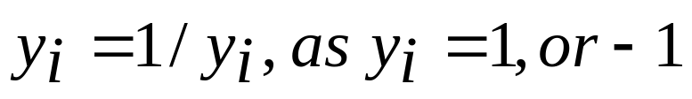
Support Vector
Lagrange multiplier condition
complementary slackness
means
Then
有了support vector 之後，我們就可以用它們來判斷新加入的點是屬於那一邊的集合
Notes:
Many possible choice of w and b, b-star can be derived from any alpha i.
Also, 1/y(i) is equal to y(i) as y(i)=1 or -1.

Slide 30
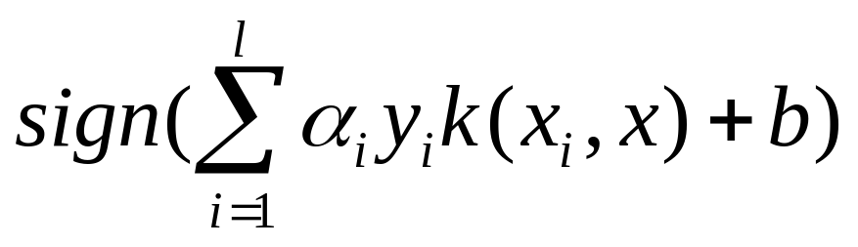
對於每一個測試資料 x 則使用下面這個函數來預測它是屬於那一種類別：

Slide 31
Non-linear SVMs
Datasets that are linearly separable with some noise work out great:
But what are we going to do if the dataset is just too hard?
How about… mapping data to a higher-dimensional space:
0
x
0
x
x²
0
x

Slide 32
Non-linear SVMs: Feature spaces
General idea: the original input space can always be mapped to some higher-dimensional feature space where the training set is separable:
Φ: x → φ(x)

Slide 33
The “Kernel Trick”
The linear classifier relies on dot product between vectors K(x_{i},x_{j})=x_{i}^{T}x_{j}
If every data point is mapped into high-dimensional space via some transformation Φ: x → φ(x), the dot product becomes:
K(x_{i},x_{j})= φ(x_{i}) ^{T}φ(x_{j})
A kernel function is some function that corresponds to an inner product in some expanded feature space.
Example:
2-dimensional vectors x=[x₁ x₂]; let K(x_{i},x_{j})=(1 + x_{i}^{T}x_{j})²,
Need to show that K(x_{i},x_{j})= φ(x_{i}) ^{T}φ(x_{j}):
K(x_{i},x_{j})=(1 + x_{i}^{T}x_{j})²,
= 1+ x_{i1}²x_{j1}² + 2 x_{i1}x_{j1} x_{i2}x_{j2}+ x_{i2}²x_{j2}² + 2x_{i1}x_{j1} + 2x_{i2}x_{j2}
= [1 x_{i1}² √2 x_{i1}x_{i2} x_{i2}² √2x_{i1} √2x_{i2}]^{T} [1 x_{j1}² √2 x_{j1}x_{j2} x_{j2}² √2x_{j1} √2x_{j2}]
= φ(x_{i}) ^{T}φ(x_{j}), where φ(x) = [1 x₁² √2 x₁x₂ x₂² √2x₁ √2x₂]

Slide 34
What Functions are Kernels?
For some functions K(x_{i},x_{j}) checking that
K(x_{i},x_{j})= φ(x_{i}) ^{T}φ(x_{j}) can be cumbersome.
Mercer’s theorem:
Every semi-positive definite symmetric function is a kernel
Semi-positive definite symmetric functions correspond to a semi-positive definite symmetric Gram matrix:
K(x₁,x₁) | K(x₁,x₂) | K(x₁,x₃) | … | K(x₁,x_{N})
K(x₂,x₁) | K(x₂,x₂) | K(x₂,x₃) |  | K(x₂,x_{N})
… | … | … | … | …
K(x_{N},x₁) | K(x_{N},x₂) | K(x_{N},x₃) | … | K(x_{N},x_{N})
K=

Slide 35
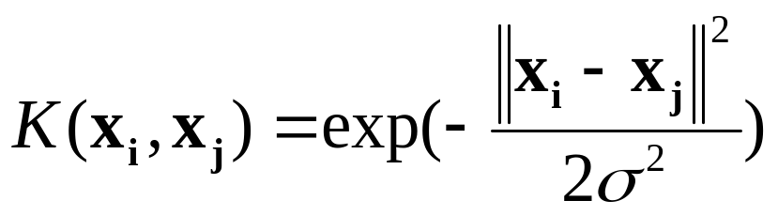
Examples of Kernel Functions
Linear: K(x_{i},x_{j})= x_{i} ^{T}x_{j}
Polynomial of power p: K(x_{i},x_{j})= (1+ x_{i} ^{T}x_{j})^{p}
Gaussian (radial-basis function network):
Sigmoid: K(x_{i},x_{j})= tanh(β₀x_{i} ^{T}x_{j} + β₁)

Slide 36
Non-linear SVMs Mathematically
Dual problem formulation:
The solution is:
Optimization techniques for finding α_{i}’s remain the same!
Find α₁…α_{N} such that
Q(α) =Σα_{i} - ½ΣΣα_{i}α_{j}y_{i}y_{j}K(x_{i}, x_{j}) is maximized and
(1) Σα_{i}y_{i} = 0
(2) α_{i} ≥ 0 for all α_{i}
f(x) = Σα_{i}y_{i}K(x_{i}, x_{j})+ b

Slide 37
Nonlinear SVM - Overview
SVM locates a separating hyperplane in the feature space and classify points in that space
It does not need to represent the space explicitly, simply by defining a kernel function
The kernel function plays the role of the dot product in the feature space.

Slide 38
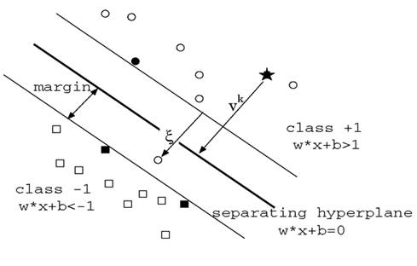
Non-Separable Case

Slide 39
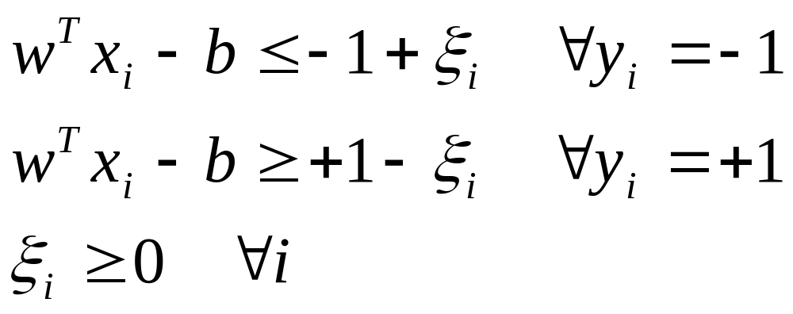
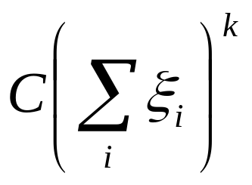
Non-Separable Case (Cont.)
penalty for ξ.
 | Cost =

Slide 40
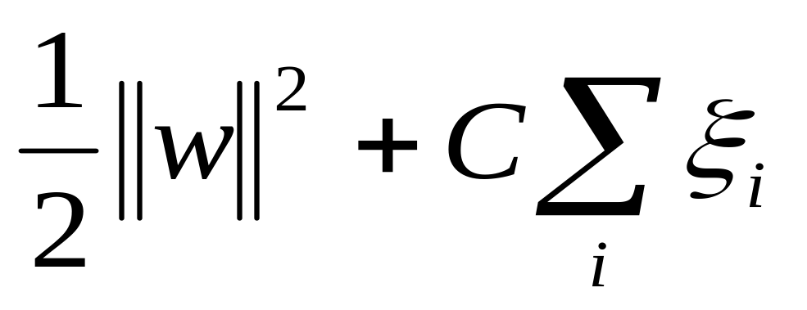
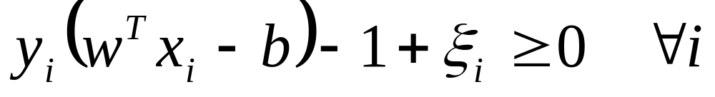
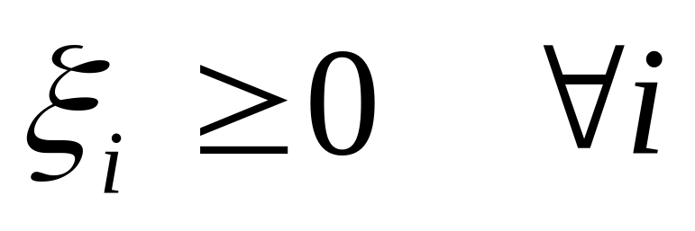
Non-Separable Case (Cont.)
minimize
subject to
Notes:
persi為鬆弛變數(Slack Variables)，當樣本資料被分到不正確之平面時persi>1，否則persi為0。 C為成本參數，其意義為對支撐向量機之懲罰程度，C愈大則代表樣本發生錯誤時，目標函數受到的影響愈大；如果想要得到較寬之邊界，則將C縮小，若欲最小化訓練誤差， 則將C增大，但通常為了避免over-fitting之情形產生，即用訓練的樣本資料進行預測可得不錯的預測效果，而應用於測試樣本時，預測能力較差，因此有時寧可選擇較大之邊界勝過較小之訓練誤差

Slide 41
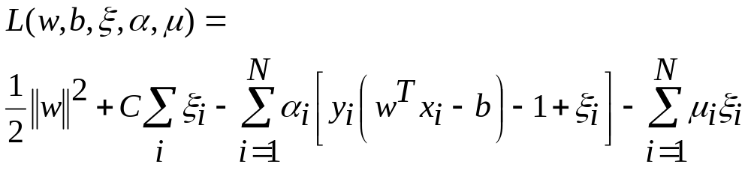
Non-Separable Case (Cont.)
Lagrange Multiplier Method

Slide 42
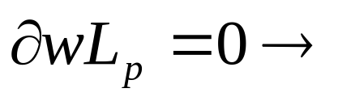
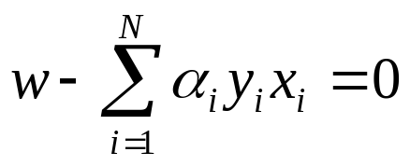
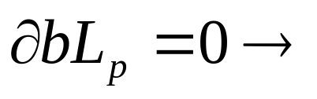








Non-Separable Case (Cont.)
Lagrange multiplier condition
Lagrange multiplier condition
complementary slackness
complementary slackness

Slide 43
Properties of SVM
Flexibility in choosing a similarity function
Sparseness of solution when dealing with large data sets
- only support vectors are used to specify the separating hyperplane
Ability to handle large feature spaces
- complexity does not depend on the dimensionality of the feature space
Overfitting can be controlled by soft margin approach
Nice math property: a simple convex optimization problem which is guaranteed to converge to a single global solution
Feature Selection

Slide 44
Advantages and disadvantages
SVMs have the following adventages:
  使用少量的樣本即可計算出最佳解
  演算法可算出全部的最佳解，而非局部最佳解
  支援向量機可將自變數與應變數的對應關係從低維度轉換至高維度，找出最佳化分類的超平面(Hyper-plane)；故支援向量機在各類型的分類問題都有極佳的成效，目前已廣泛運用在生物科技、文字分類、影像辨識等領域
  Learning fast、testing fast、high accuracy

Slide 45
Advantages and disadvantages
SVMs have the following disadventages:
  無法得到機率式的預測。一般人會比較偏好機率式的預測，因為機率式的預測能夠 給人確定程度的資訊。就和氣象預報不會單純預測天氣為晴天或雨天，而會預測降雨機率的道理一般
  Hard to find optimal kernel function
  High computing load

Slide 46
Comparison of Classifiers
SVM | Learning fast Testing fast High accuracy | Hard to find optimal kernel function High computing load
 | Advantages | Disadvantages
Decision Tree | Understanding easily Low computing cost | Nominal features Judging only one feature each time
Bayesian | Learning fast Testing fast | NOT suiting unbalanced classes
K-NN | Constructing easily Learning fast | Testing slowly: Many features Large training data
SVM
Related Work
Notes:
接著我們簡單比較一下各分類法的幽缺點
* 決策樹雖然可以產出明確的規則，且運算量相對較小，但是只適用量化的特徵，且一次只考慮一個特徵
* 貝氏分類法在學習與分類的速度都很快，但若類別大小差距過大，可能會有大類別搶走過多對應特徵的狀況
* KNN的概念很簡單，但缺點是分類時運算量很大，尤其是特徵與訓練資料
* SVM學習與分類的速度都很快，而且準確率一般也都相當高，缺點是運算量相對較大且數學理論較為艱深
依資料的不同各分類法的表現也互有消長
目前為止並沒有任何一種分類法可以在任何資料上稱霸群雄
綜合以上各點與前人的研究，SVM，我們選用SVM做為書籍分類系統的分類技術。

Slide 47
Reference
Support Vector Machine Classification of Microarray Gene Expression Data, Michael P. S. Brown William Noble Grundy, David Lin, Nello Cristianini, Charles Sugnet, Manuel Ares, Jr., David Haussler
www.cs.utexas.edu/users/mooney/cs391L/svm.ppt
Text categorization with Support Vector Machines:
learning with many relevant features
T. Joachims, ECML - 98

